Slide 1

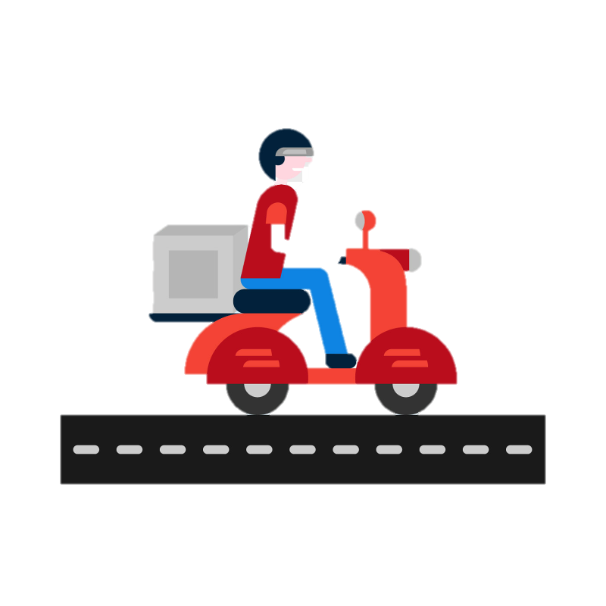
Food Delivery App System Empowering Small & Local Food Businesses
FOODELICIOUS
NAME: MUSKAN KUMARI
ROLL NO: CS-2341807
3CSE9
GUIDE: Ms. Parul Saini

Slide 2

Problem Statement:
Big food delivery apps like Zomato & Swiggy charge 25% to 30% commission per order.
Small restaurants, street food vendors, and home-based kitchens cannot afford such high charges.
These local businesses remain offline or lose customers.
Customers also miss out on good local food because it's not available online.
Existing platforms are too complex for small vendors to understand and use.
➡️ Need: A low-cost, simple, and local-friendly food delivery system

Slide 3

Objective
Objective
To design and develop a web-based food delivery application.
Focus on small restaurants, street food stalls, and home-based food businesses.
Provide a platform with:
Low commission charges (5-10%)
Simple user interface in Hindi & English
No hidden fees
Easy order management
Help small food businesses go digital and grow.

Slide 4

Key Features (For Small Businesses)
✅ Free Registration for first 3 months ✅ Low Commission (only 5-10% per order) ✅ Manual Order Acceptance – Accept or reject orders based on kitchen availability ✅ Own Delivery or Platform Delivery – Flexibility to use their own rider ✅ Multi-Language Dashboard – Hindi & English support ✅ Simple Interface – Big buttons, easy to understand ✅ No Technical Knowledge Required ✅ Transparent Earnings – Daily/weekly/monthly reports

Slide 5
Key Features (For Customers)
✅ Browse Local Restaurants & Street Food near you ✅ Search by Food Type, Price, or Location ✅ Add to Cart & Place Order easily ✅ Real-Time Order Tracking – Live status update ✅ Multiple Payment Options:
UPI (Google Pay, Phone Pay, Paytm)
Cash on Delivery
Debit/Credit Card ✅ Rate & Review food and restaurants ✅ Order History – Reorder easily

Slide 6
Technology Stack
Layer | Technology Used
Frontend | HTML, CSS, JavaScript, React.js
Backend | Node.js / PHP (Laravel) / Python (Django)
Database | MySQL / MongoDB
APIs | Google Maps API, Razorpay / Stripe (Payments)
Languages | English, Hindi (Multi-language support)
Tools | VS Code, Git

Slide 7
System Architecture (FLOWCHART)
👤 USER
↓
🍽️ BROWSE RESTAURANTS
↓
🍔 SELECT FOOD ITEMS
↓
🛒 ADD TO CART
↓
📦 PLACE ORDER
↓
💳 PAYMENT GATEWAY
↓
✅ ORDER CONFIRMED
↓
🚚 REAL-TIME TRACKING
↓
🏠 DELIVERY COMPLETE
↓
⭐ RATING & REVIEW

Slide 8
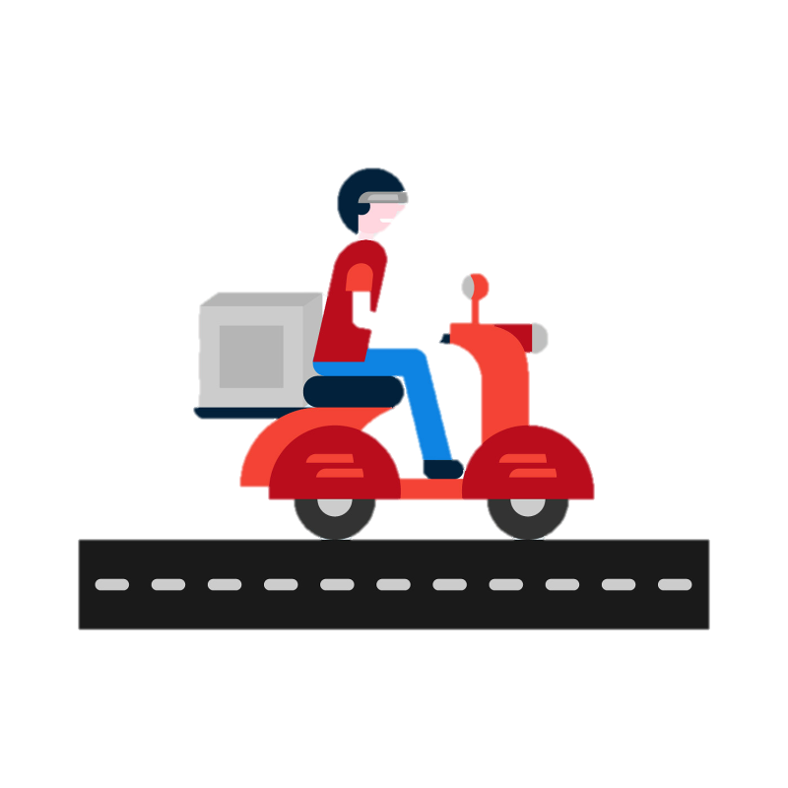
Modules Description
Details:
1.User Module
Register / Login
Browse restaurants & menu
Place order & make payment
Track order & give rating
2.Restaurant Module
Add/Update menu with prices
View incoming orders
Accept or reject orders
View earnings
3.Delivery Module
See assigned orders
Update delivery status (Picked Up, On the Way, Delivered)
4.Admin Module
Manage users, restaurants, delivery boys
Monitor orders and payments
Set commission rates
Generate reports

Slide 9
Conclusion
This project aims to build a food delivery platform with a social cause – helping small businesses grow.
It is low-cost, simple, and focused on local needs.
It bridges the gap between local food lovers and small restaurants.
Promotes the idea: "Support Local, Eat Fresh".
Technically strong, scalable, and user-friendly.

Slide 10

FOODLICIOUS
EAT FRESH, FLAVORFUL
THANKYOU

